Slide 1
CHAPTER 8
The balance sheet:
Components and applications

Slide 2
Learning objectives
After reading this chapter, students should be able to do the following:
8.1 Explain the purpose of the balance sheet and the link to the income statement.
8.2 Understand the relationship between the accounting equation and the balance sheet.

Slide 3
Key questions
What information does a balance sheet convey to users of accounting information?
Why is it important to classify assets and liabilities into groups when preparing a balance sheet?

Slide 4
8.1 Why the balance sheet is important
What assets do you own?
A balance sheet provides information that helps internal and external users to evaluate a business’s ability to achieve its primary goals of earning a satisfactory proﬁt and remaining solvent.
So the income statement reports on a business’s actions over a period of time, representing the ‘ﬂow’ of a business’s operating activities.

Slide 5
8.1 Why the balance sheet is important
Why users need both the balance sheet and the income statement
An investor analyses a balance sheet to take stock of a business’s ﬁnancial resources.
Corporate social responsibility (CSR) disclosure is also becoming an important part of the balance sheets of businesses.

Slide 6
8.2 The accounting equation and the balance sheet
The ﬁnancial accounting process is based on a simple equation:
Economic resources = Claims on economic resources
Using accounting terminology, we restated the equation as follows:
Assets = Liabilities + Owner’s equity
The equality of the assets to the liabilities plus owner’s equity is the reason a business’s statement of ﬁnancial position is often called a balance sheet.

Slide 7
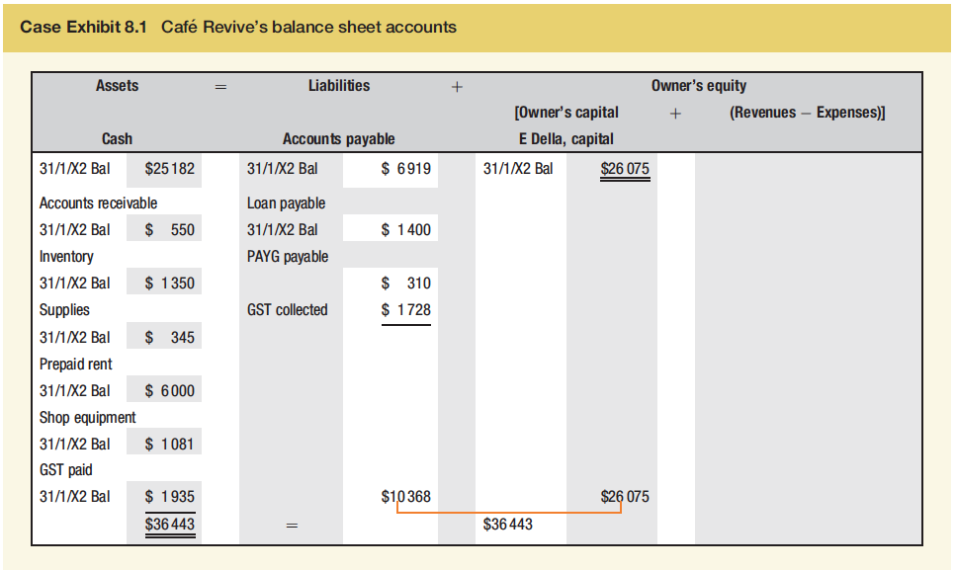
8.2 The accounting equation and the balance sheet
Case Exhibit 8.1 Café Revive’s balance sheet accounts
The report form of balance sheet is common because it is easier to show the accounts vertically on a standard sheet of paper.

Slide 8
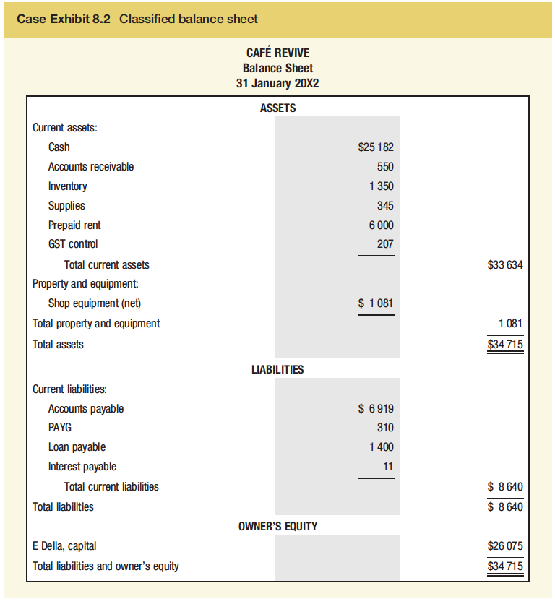
8.2 The accounting equation and the balance sheet
Case Exhibit 8.2 Classiﬁed balance sheet
Café Revive’s balance sheet is called a classiﬁed balance sheet because the balance sheet shows subtotals for assets, liabilities and owner’s equity in related groupings.

Slide 9
8.2 The accounting equation and the balance sheet
Assets are a business’s economic resources that it expects will provide future beneﬁts to the business.
Current assets are cash and other assets that the business expects to convert into cash, sell or use up within one year.
Examples of current assets:
cash
marketable securities
receivables
inventory
prepaid items.

Slide 10
8.2 The accounting equation and the balance sheet
Non-current assets – Any item that is not classified as a Current Asset.
Financial assets include items such as notes receivable, government bonds, bonds and share capital of companies, and other securities.
Property and equipment includes all the physical, long-term assets used in the operations of a business - often referred to as ﬁxed assets or operating assets because of their relative permanence in the business’s operations.
The book value of an asset is its original cost minus the related accumulated depreciation.
Accumulated depreciation is the total amount of depreciation expense recorded over the life of an asset to date; thus, it is the portion of the asset’s cost that has been ‘used up’ to earn revenues to date.

Slide 11
Current and Non-current Assets
How are current and non-current assets differentiated? Ask
  What is the intention of the business when it acquires the asset?
  Is it meant for use or sale?
  For example a van for sale at a vehicle sales yard is a current asset, but when it is bought by a furniture removal business, to that business it is a non-current asset.
  Assets are grouped and then listed on the Balance Sheet in their order of liquidity.

Slide 12
The cost of a non-current asset
Includes:
at acquisition
  all reasonable and necessary expenditures incurred to place the asset in a position and condition ready for use
subsequent to acquisition
  all expenditures which enhance the future economic benefits of the asset beyond those initially expected; and/or
  extend the useful life of the asset

Slide 13
8.2 The accounting equation and the balance sheet
Liabilities are the economic obligations (debts) of a business.
Current liabilities are obligations that the business expects to pay within one year by using current assets. Including:
  accounts payable and salaries payable
  unearned revenues
  short-term loans and notes (and interest) payable.

Slide 14
8.2 The accounting equation and the balance sheet
Non-current (long-term) liabilities are obligations that a business does not expect to pay within the next year. Examples:
  long-term notes payable
  mortgages payable
  bonds payable.

Slide 15
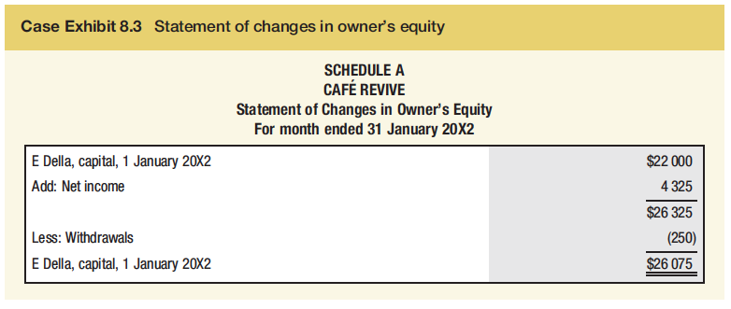
8.2 The accounting equation and the balance sheet
Owner’s equity is the owner’s current investment in the assets of the business. It is the business’s assets less its liabilities.
Case Exhibit 8.3 Statement of changes in owner’s equity
Note that we show the $26 075 ending amount of ‘E Della, capital’ from the balance sheet in Case Exhibit 8.2. The $34 715 total liabilities and owner’s equity ($8640 total liabilities + $26 075 owner’s equity) is equal to the $34 715 total assets.

Slide 16
Materiality
Broadly, an item can be said to be material if its omission or misstatement could influence the economic decisions of users taken on the basis of the financial statements.
(NZ Framework, para. 30)
Relates to the fundamental qualitative characteristic, Relevance

Slide 17
Impact of classification
Wrong classification of expenditure as the cost of the asset will overstate assets and profit
Wrong classification of expenditure as an expense will understate assets and profit

Slide 18
Property and equipment
(More on this Week 9)
Land is listed on the balance sheet at its original cost. The remaining fixed assets are listed at their book values.
Cost – accumulated depreciation = Net Book Value. (Written down value)
Book value
Original cost
Accumulated depreciation

Slide 19
Intangible Assets
Intangibles are deﬁned by NZ IAS 138 Intangible Assets as ‘an identiﬁable non-monetary asset without physical substance’.
Intangible assets do not have physical substance
They must meet the following criteria
  will bring future economic benefits
  Are under the control of the business
  Are the result of a past transaction or event

Slide 20
Identifiable intangible assets
Identifiable intangible assets are assets that are capable of being individually identified and recorded.
For example:
  patents
  brand names
  trademarks

Slide 21
Unidentifiable intangible assets
Goodwill is the future benefit from unidentifiable assets. It reflects the entity’s excess value as a whole over the aggregate of the individual values of its net assets
For example:
  market penetration
  effective advertising
  good labour relations

